Slide 1
Utrecht Summer School:
Programming with Python 2023
Unit 2.3: Data Structures II

Slide 2
Previous Lecture
Data Structures: Lists, Tuples

Slide 3
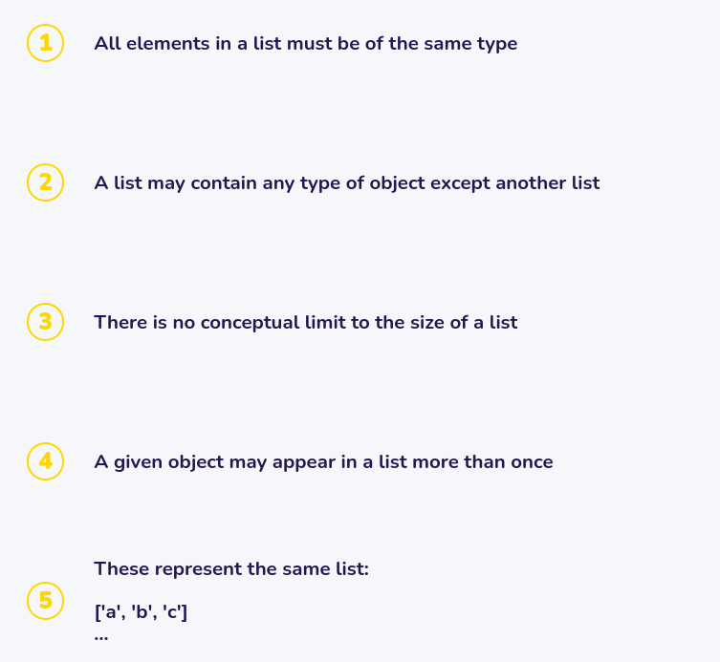
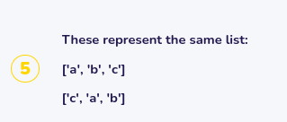
Which of the following are true of Python lists?

Slide 4
Which of the following are true of Python lists?

Slide 5
Sets
Unordered
Mutable
Unique
Iterable

Slide 6

Sets: Unordered

Slide 7

Sets: Unique

Slide 8
Set Operations
Symbol | Name | Example
| | Union | {2, 3} | {3, 4} → {2, 3, 4}
& | Intersection | {2, 3} & {3, 4} → {3}
- | Difference | {2, 3} – {3, 4} → {2}
^ | Symmetric Difference | {2, 3} ^ {3, 4} → {2, 4}
<= | Subset | {2, 3} <= {3, 4} → False {2, 3} <= {2, 3, 4} → True

Slide 9
Set Operations
Symbol | Name | Example
| | Union | {2, 3} | {3, 4} → {2, 3, 4}
& | Intersection | {2, 3} & {3, 4} → {3}
- | Difference | {2, 3} – {3, 4} → {2}
^ | Symmetric Difference | {2, 3} ^ {3, 4} → {2, 4}
<= | Subset | {2, 3} <= {3, 4} → False {2, 3} <= {2, 3, 4} → True
A
B
B
A
A <= B –>False
A <= B –>True

Slide 10
Set Methods
Symbol | Name | Explanation
add | aset.add(item) | Insert item into aset
remove | aset.remove(item) | Remove item from aset
pop | aset.pop() | Remove a random element from aset
clear | aset.clear() | Remove all elements from aset

Slide 11
Dictionaries
Unordered
Mutable
Unique Keys
Iterable

Slide 12
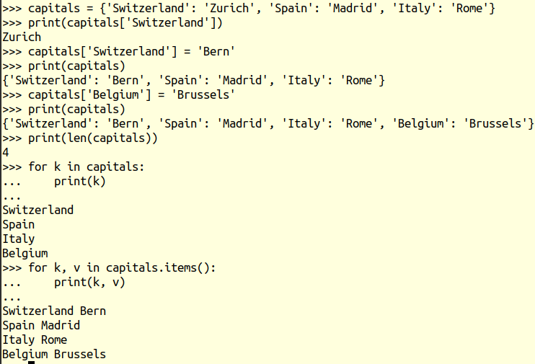
Dictionaries
capitals = {‘Switzerland’: ‘Zurich’, ‘Spain’: ‘Madrid’, ‘Italy’: ‘Rome’}

Slide 13

Dictionaries: Unordered

Slide 14
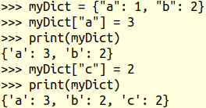
Dictionaries: Unique Keys

Slide 15
Dictionary Operations
capitals = {‘Switzerland’: ‘Bern’, ‘Spain’: ‘Madrid’, ‘Italy’: ‘Rome’}
Operator | Use | Example1 | Example2
[] | capitals[k] | capitals[‘Spain’] → ‘Madrid’ | capitals[‘Netherlands’] → KeyError
in | key in capitals | ‘Spain’ in capitals → True | ‘Madrid’ in capitals → False
del | del capitals[key] | del capitals[‘Spain’] → remove (‘Spain’, ‘Madrid’) entry | del capitals[‘Netherlands’] → KeyError

Slide 16
Dictionary Methods
capitals = {‘Switzerland’: ‘Bern’, ‘Spain’: ‘Madrid’, ‘Italy’: ‘Rome’}
Operator | Use | Return value | Type
keys | capitals.keys() | ‘Switzerland’, ‘Spain’, ‘Italy’ | dict_keys
values | capitals.values() | ‘Bern’, ‘Madrid’, ‘Rome’ | dict_values
items | capitals.items() | (‘Switzerland’, ‘Bern’), (‘Spain’, ‘Madrid’), (‘Italy’, ‘Rome’) | dict_items

Slide 17
Mixed-Type Collections
aList = [2, 2.5, True, “something”]
aSet = {2, 2.5, True, “something”}
aTuple = (2, 2.5, True, “something”)
aDict = {3: "t",
2.5: False,
"something": 42,
True: "t"}

Slide 18


Slide 19
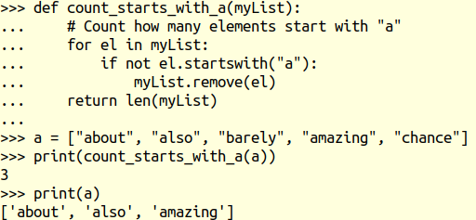
Calling Methods with References

Slide 20
Next Lecture
Object-Oriented Programming

